Slide 1
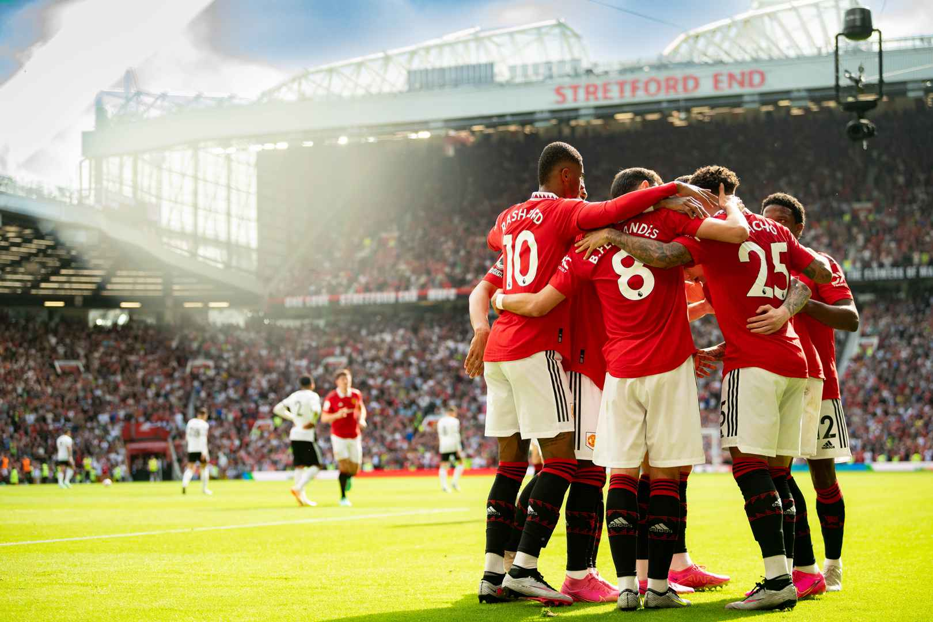
Manchester United’s Performance Analysis
A 2023/2024 Season

Slide 2
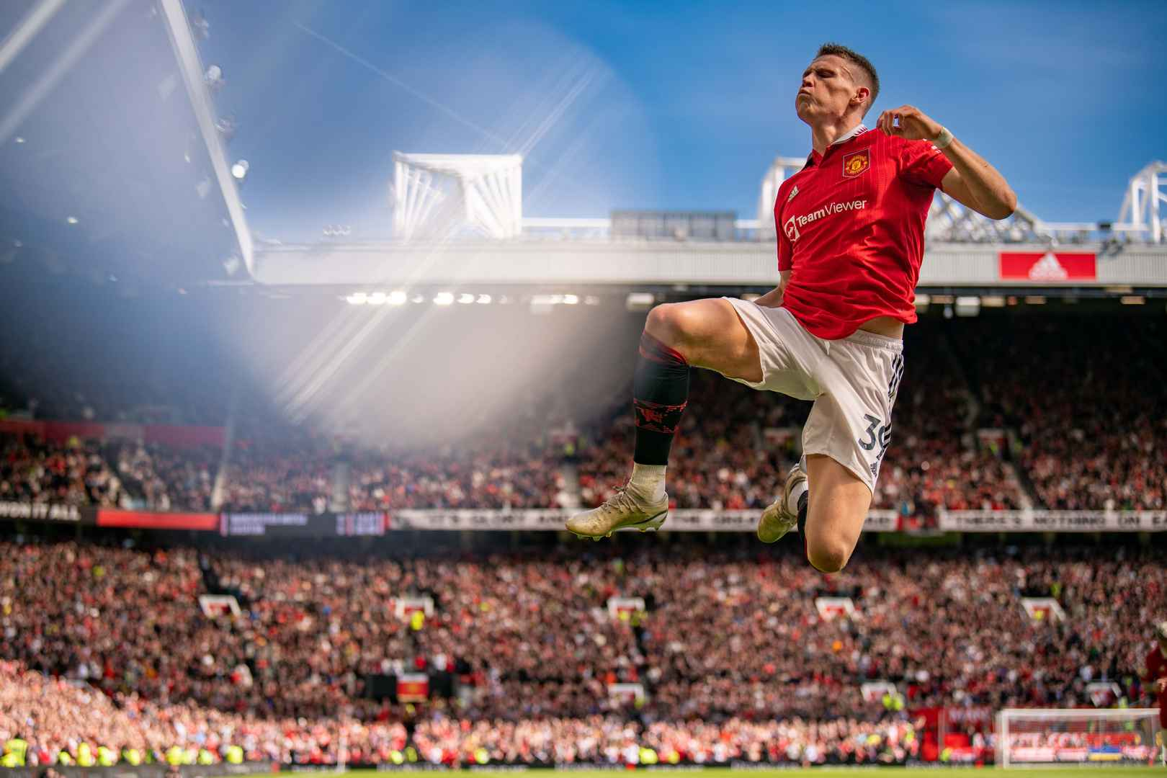
Introduction
Brief overview of the analysis
Objectives of the presentation
Importance of data-driven decisions in sports

Slide 3
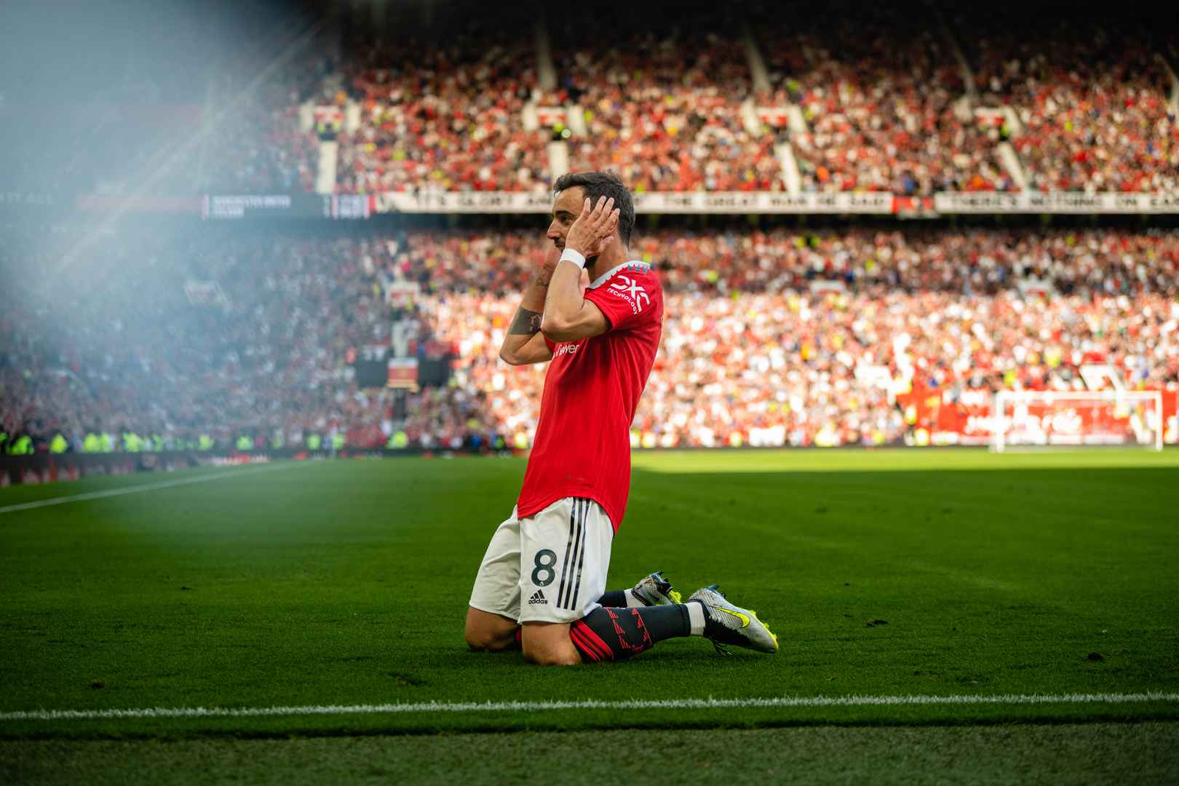
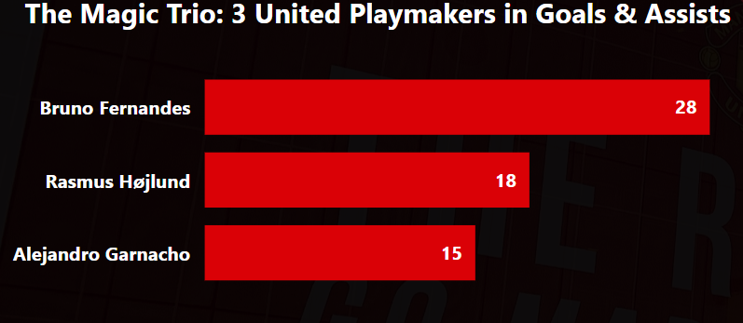
The Magic Trio: Key Playmakers
Bruno Fernandes, Rasmus Højlund, and Alejandro Garnacho:
The leading contributors in terms of goals and assists.
Continue leveraging the playmaking abilities of Bruno Fernandes and the attacking contributions of Rasmus Højlund and Alejandro Garnacho.
Focus on creating more scoring opportunities through the midfield.

Slide 4
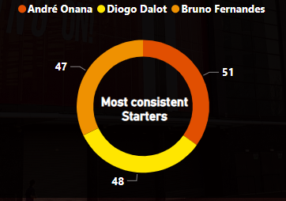
Most Consistent Starters
Andre Onana, Diogo Dalot & Bruno Fernandes:
The most consistent players in the team.
High energy and less injuries.
Continue to ensure that they play more games as they did.

